Slide 1

COMM3590
Week 9
Unit 8: Adjusting to your Audience

Slide 2
Chapter 6: Considering Audience Feedback
Success in any communication situation depends on meeting the needs of the audience.
In dyadic/ group encounters, we adapt to audiences through empathy (listening, feedback, role-taking)
In public presentation/ bigger context → Audience analysis

Slide 3
AUDIENCE analysis- Situation
Occasion
1. purpose
- event
2. context
- larger theme - other speakers
Size
1. Formality
- When size increase → ?
How to decrease formality?
Organizational Culture
Power Distance
Time
Time allotted
Time management
K.I.S.S.
Physical Environment
Lectern/ Stage
PPT
Food/ Tables

Slide 4
AUDIENCE analysis- FEATURES
Demographics
age, gender, economic status, education, geographical location
Young students vs. Working adults
Female vs. Male Audiences
Cultural Differences
Topics?
Jargons?
Northern vs. Southern Culture?

Slide 5
AUDIENCE analysis- FEATURES
2. Captivity
Voluntary or required to attend?
Lively material
Additional motivation
Need more effort to retain their attention
How to attract attention?

Slide 6
AUDIENCE analysis- FEATURES
3. Predisposition Toward the Speaker
The audience’s view of the speaker’s credibility
It’s crucial to establish your credibility in the beginning
How to Establish Credibility?

Slide 7
AUDIENCE analysis- FEATURES
4. Predisposition Toward the Topic
Perceptions based on listeners’ knowledge of the topic and their meaning for the topic
Unaware
Audience’s Knowledge on the Topic
Expert
Minimal knowledge
Strong justification
Extensive background
Define concepts
Avoid jargon
Use visual aids
Explain visual aids
Extensive knowledge
Justification optional
Background optional
Define unclear terms
Jargon may be appropriate
Visual aids optional
Less extensive VA explanations

Slide 8
AUDIENCE analysis- FEATURES
4. Predisposition Toward the Topic
Perceptions based on listeners’ knowledge of the topic and their meaning for the topic
Unaware
Meaning for the Topic
Expert
Minimal knowledge
Strong justification
Extensive background
Define concepts
Avoid jargon
Use visual aids
Explain visual aids
Extensive knowledge
Justification optional
Background optional
Define unclear terms
Jargon may be appropriate
Visual aids optional
Less extensive VA explanations
Question:
Mixed audiences??

Slide 9
AUDIENCE analysis- FEATURES
Meaning for the Topic
The audience’s interpretation, positive, negative, or neutral, and the reason they hold this interpretation
Positive
Favorable
Active
Meaning
Neutral
Negative
Apathetic
Hostile
Minimal
Expert
Knowledge

Slide 10
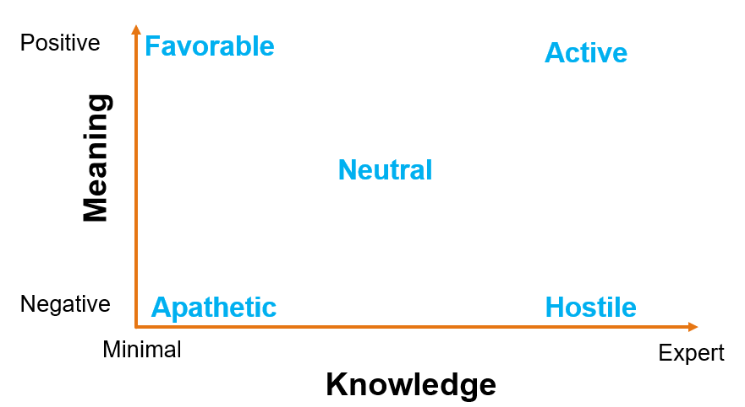
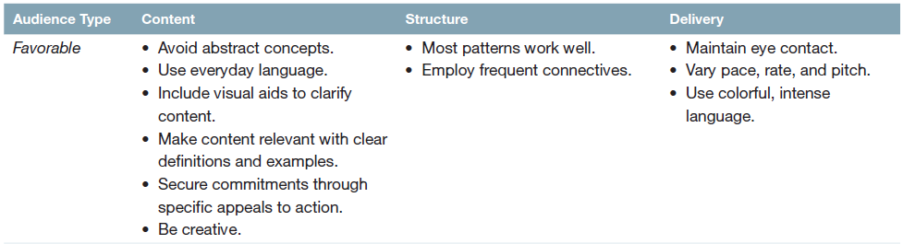
Example: Society Recruitment Day
V.I.P. Sale
DiSanza, J. R., & Legge, N. J. (2017)

Slide 11
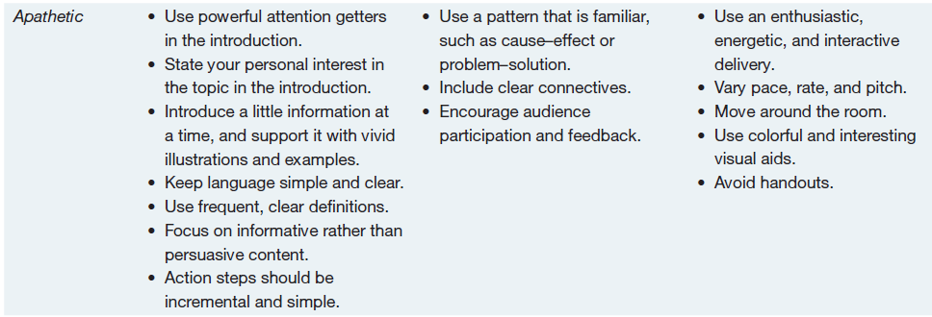
DiSanza, J. R., & Legge, N. J. (2017)

Slide 12
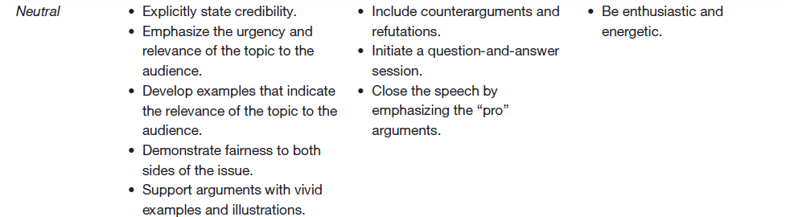
DiSanza, J. R., & Legge, N. J. (2017)

Slide 13
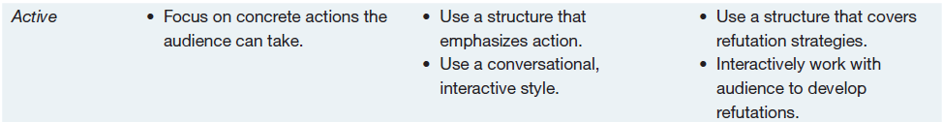
DiSanza, J. R., & Legge, N. J. (2017)

Slide 14
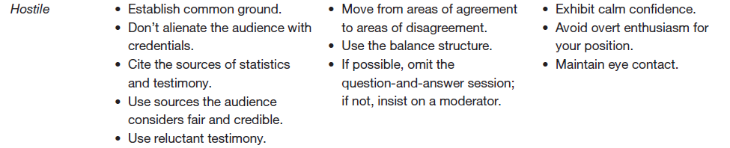
Example: Controversial Issues- To build a factory in a village
DiSanza, J. R., & Legge, N. J. (2017)

Slide 15
Mixed Audience
First Type:
No clear pattern to beliefs and attitudes toward the topic
Second Type:
Audience divided into two or three categories
Consists of all 5 types
Delivery > Content
Be adaptive
Keep observing responses & respond (Empathy)
an equal number of favorable, neutral, and hostile members.
Probably impossible to make an equally persuasive presentation
Choose 1 @ 2 types (target audience)

Slide 16
Techniques for Analyzing the Audience
Keep the Survey Style Clean and Simple
Avoid Faulty Questions
Double-barreled questions
Loaded questions
3. Open-Ended versus Closed-Ended Questions

Slide 17
HOMEWORK- DQ 9
Discussion Question (DQ9)
Points: | 15pts
Initial Post: | Thursday, 11.59pm
Responses: | Sunday, 11.59pm
Forum will no longer be available 48 hours after the due date
Both open-ended and close-ended questions are techniques used in audience analysis.
Provide an example question for each of the techniques and explain your answers.
You need to cite at least 2 reliable sources in your answers.

Slide 18
HOMEWORK- AS9 (40 pts) Due Date: 09 November 2021
This is a GROUP work.
Find a job ad for which you want to apply on Linkedin (English ONLY).
Conduct research online for extra information of the organization and the recruiter
Analyze how you should adjust to present yourself in the most excellent way to the recruiter during your job interview
Write about the different characteristics to adjust for in
A situational analysis (Occasion, Size, Organizational Culture, Physical Environment, Time)
An audience analysis (Demographics, Captivity, Predispositions)
Cite at least THREE (3) reliable sources in your assignment.

